Slide 1
Preliminaries Required
Basic knowledge of programming languages.
Basic knowledge of FSA and CFG.
Knowledge of a high programming language for the programming assignments.
Book:
Alfred V. Aho, Ravi Sethi, and Jeffrey D. Ullman,
“Compilers: Principles, Techniques, and Tools”
Holub - “Compiler Design in C” – PHI
  Cooper & Torczon – “Engineering a Compiler”

Slide 2
Course Description/Lesson Plan
Unit-1: Introduction to Compiling [3L]
Unit-2: Lexical Analysis [5L]
Unit-3: Syntax Analysis [6L]
Unit-4: Semantic Analysis [4L]
Unit-5: Symbol Table [2L]
Unit-6: Run Time Environments [3L}
Unit-7: Intermediate Code Generation [3L]
Unit-8: Code Optimization [5L]
Unit-9: Code Generation [5L]

Slide 3
Course Objectives
To understand and list the different stages in the process of compilation.
Identify different methods of lexical analysis.
Design top-down and bottom-up parsers.
Identify synthesized and inherited attributes.
Develop syntax directed translation schemes.
Develop algorithm to generate code for a target machine.

Slide 4
Course Outcomes
Understand and develop the lexical analyzer from a given specification
Design top-down and bottom-up parsers from a given parser specification
Develop syntax directed translation schemes
Develop algorithms to generate optimized code for a target machine

Slide 5
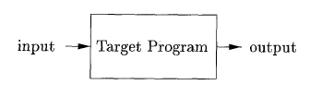
COMPILERS
A compiler is a program takes a program written in a source language and translates it into an equivalent program in a target language.
source program COMPILER target program
error messages
( Normally a program written in
a high-level programming language)
( Normally the equivalent program in
machine code – relocatable object file)

Slide 6
Other Applications
In addition to the development of a compiler, the techniques used in compiler design can be applicable to many problems in computer science.
  Techniques used in a lexical analyzer can be used in text editors, information retrieval system, and pattern recognition programs.
  Techniques used in a parser can be used in a query processing system such as SQL.
  Many software having a complex front-end may need techniques used in compiler design.
    A symbolic equation solver which takes an equation as input. That program should parse the given input equation.
  Most of the techniques used in compiler design can be used in Natural Language Processing (NLP) systems – spam filter, search, …
  Mathematics (mathematica, matlab)

Slide 7
The Fundamental Principles of Compilation
The first principle is inviolable:
The compiler must preserve the meaning of the program being compiled.
The second principle that a compiler must observe is practical:
The compiler must improve the input program in some discernible way.

Slide 8
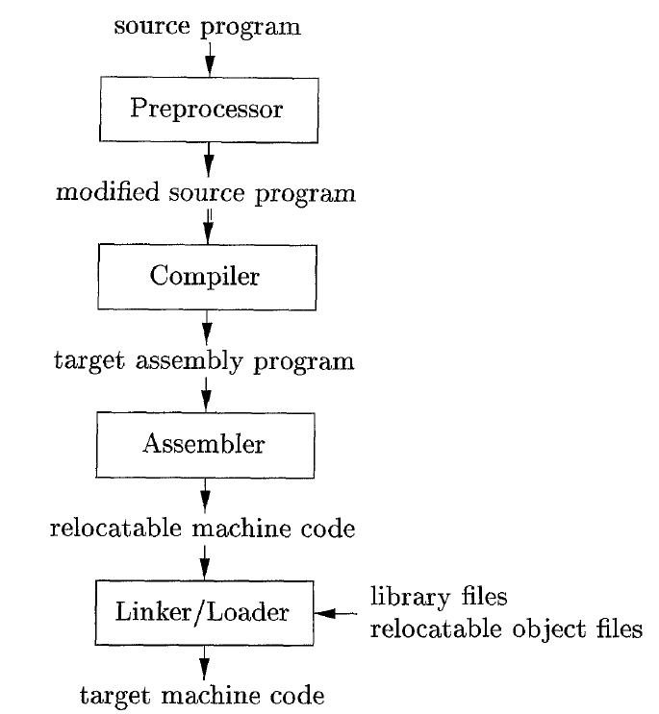
Context of a Compiler
Preprocessor :
Expands macros -
#define compute(x, y) ((5+x)*x*(y+2))
a = compute(b, c) becomes
a = ((5+b)*b*(c+2))
Includes header files –
#include<stdio.h>
Replaced by the content of stdio.h
Assembler :
- Generates a relocatable code
Linker :
- Combines object code, standard library functions and resources supplied by the OS
Loader :
- Calculates absolute addresses and loads the relocatable code

Slide 9
Major Parts of Compilers
There are two major parts of a compiler: Analysis and Synthesis
In analysis phase, an intermediate representation is created from the given source program.
  Lexical Analyzer, Syntax Analyzer and Semantic Analyzer are the parts of this phase.
In synthesis phase, the equivalent target program is created from this intermediate representation.
  Intermediate Code Generator, Code Generator, and Code Optimizer are the parts of this phase.

Slide 10
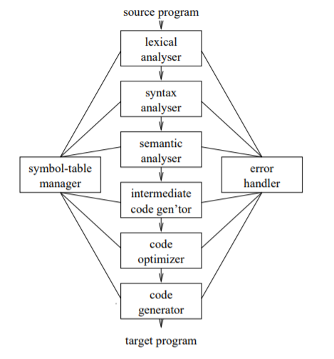
Phases of a Compiler
Each phase transforms the source program from one representation into another representation.
They communicate with error handlers.
They communicate with the symbol table.

Slide 11
Lexical Analyzer
Lexical Analyzer reads the source program character by character and returns the tokens of the source program.
A token describes a pattern of characters having same meaning in the source program. (such as identifiers, operators, keywords, numbers, delimeters and so on)
Ex: newval := oldval + 12 => lexeme token
newval identifier
:= assignment operator
oldval identifier
+ add operator
12 a number
Puts information about identifiers into the symbol table.
Regular expressions are used to describe tokens (lexical constructs).
A (Deterministic) Finite State Automaton can be used in the implementation of a lexical analyzer.
Remove white space characters.

Slide 12
Syntax Analyzer
A Syntax Analyzer creates the syntactic structure (generally a parse tree) of the given program.
A syntax analyzer is also called as a parser.
A parse tree describes a syntactic structure.
assgstmt
identifier := expression
newval expression + expression
identifier number
oldval 12
In a parse tree, all terminals are at leaves.
All inner nodes are non-terminals in
a context free grammar.

Slide 13
Syntax Analyzer (CFG)
The syntax of a language is specified by a context free grammar (CFG).
The rules in a CFG are mostly recursive.
A syntax analyzer checks whether a given program satisfies the rules implied by a CFG or not.
  If it satisfies, the syntax analyzer creates a parse tree for the given program.
Ex: We use BNF (Backus Naur Form) to specify a CFG
assgstmt -> identifier := expression
expression -> identifier
expression -> number
expression -> expression + expression

Slide 14
Syntax Analyzer versus Lexical Analyzer
Which constructs of a program should be recognized by the lexical analyzer, and which ones by the syntax analyzer?
  Both of them do similar things; But the lexical analyzer deals with simple non-recursive constructs of the language.
  The syntax analyzer deals with recursive constructs of the language.
  The lexical analyzer simplifies the job of the syntax analyzer.
  The lexical analyzer recognizes the smallest meaningful units (tokens) in a source program.
  The syntax analyzer works on the smallest meaningful units (tokens) in a source program to recognize meaningful structures in our programming language.

Slide 15
Parsing Techniques
Depending on how the parse tree is created, there are different parsing techniques.
These parsing techniques are categorized into two groups:
  Top-Down Parsing,
  Bottom-Up Parsing
Top-Down Parsing:
  Construction of the parse tree starts at the root, and proceeds towards the leaves.
  Efficient top-down parsers can be easily constructed by hand.
  Recursive Predictive Parsing, Non-Recursive Predictive Parsing (LL Parsing).
Bottom-Up Parsing:
  Construction of the parse tree starts at the leaves, and proceeds towards the root.
  Normally efficient bottom-up parsers are created with the help of some software tools.
  Bottom-up parsing is also known as shift-reduce parsing.
  Operator-Precedence Parsing – simple, restrictive, easy to implement
  LR Parsing – much general form of shift-reduce parsing, LR, SLR, LALR

Slide 16
Semantic Analyzer
A semantic analyzer checks the source program for semantic errors and collects the type information for the code generation.
Type-checking is an important part of semantic analyzer.
Normally semantic information cannot be represented by a context-free language used in syntax analyzers.
Context-free grammars used in the syntax analysis are integrated with attributes (semantic rules)
  the result is a syntax-directed translation,
  Attribute grammars
Ex:
  newval := oldval + 12
    The type of the identifier newval must match with type of the expression (oldval+12)

Slide 17
Intermediate Code Generation
A compiler may produce an explicit intermediate codes representing the source program.
These intermediate codes are generally machine (architecture independent). But the level of intermediate codes is close to the level of machine codes.
Ex:
  newval := oldval * fact + 1
  id1 := id2 * id3 + 1
  MULT id2,id3,temp1 Intermediates Codes (Quadraples)
  ADD temp1,#1,temp2
  MOV temp2,,id1

Slide 18
Code Optimizer (for Intermediate Code Generator)
The code optimizer optimizes the code produced by the intermediate code generator in the terms of time and space.
Ex:
  MULT id2,id3,temp1
  ADD temp1,#1,id1

Slide 19
Code Generator
Produces the target language in a specific architecture.
The target program is normally is a relocatable object file containing the machine codes.
Ex:
( assume that we have an architecture with instructions whose at least one of its operands is
a machine register)
  MOVE id2,R1
  MULT id3,R1
  ADD #1,R1
  MOVE R1,id1

Slide 20
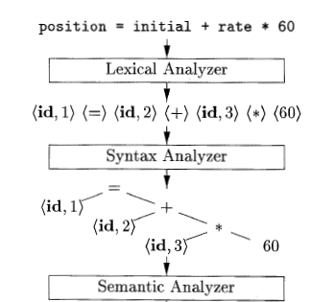
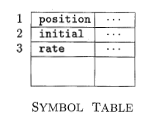
Translation of an Assignment Statement

Slide 21
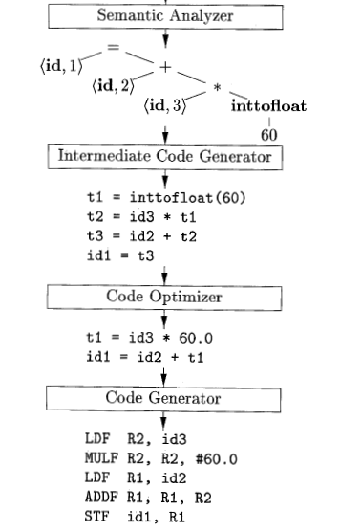
Translation of an Assignment Statement

Slide 22
Challenges
Many variations
  many programming languages (C, FORTRAN, JAVA etc.)
  many programming paradigms (Procedural, OO, Functional etc.)
  many computer architecture (SPARC, Intel etc.)
  many operating systems (Windows, Unix etc
Quality of a compiler
  correct target code
  faster
  portable
  debugger

Slide 23
Cousins of Compiler
Preprocessor
Assembler
Loader
Linker
Interpreter

Slide 24
Compilers: A microcosm of CSE
Formal Language and Automata Theory
Data Structures and Algorithms
Computer Architecture
Programming Language Semantics
Formal reasoning about programs
Software Engineering aspects

